Slide 1
PM2.5

Slide 2
Table 4 Summary statistics for PM2.5 concentration in the pregnant cohort.
 | N | mean | sd | min | max | p50 | iqr | p25 | p75 | p5 | p95
PM2.5 period | 13201 | 62.6 | 25.5 | 5.9 | 195.8 | 59.4 | 34.9 | 43.6 | 78.6 | 26.2 | 110.4
First trimester | 13201 | 62.2 | 43.9 | 1.5 | 252.7 | 51.5 | 65.0 | 25.3 | 90.3 | 11.6 | 146.4
Second trimester | 13201 | 63.8 | 44.7 | 1.7 | 362.9 | 53.7 | 67.3 | 25.9 | 93.2 | 11.4 | 149.2
Third trimester | 13095 | 59.8 | 43.8 | 1.6 | 315.1 | 48.5 | 62.9 | 23.6 | 86.6 | 10.7 | 145.1
First 20 weeks | 13201 | 63.1 | 38.4 | 2.0 | 209.5 | 56.6 | 56.4 | 31.3 | 87.6 | 14.8 | 137.1

Slide 3
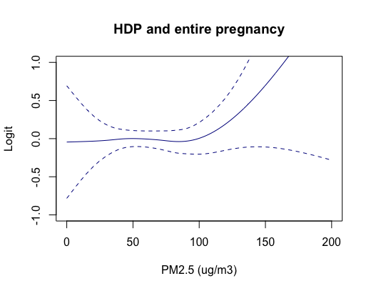
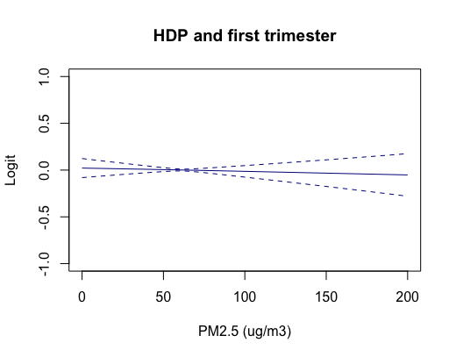
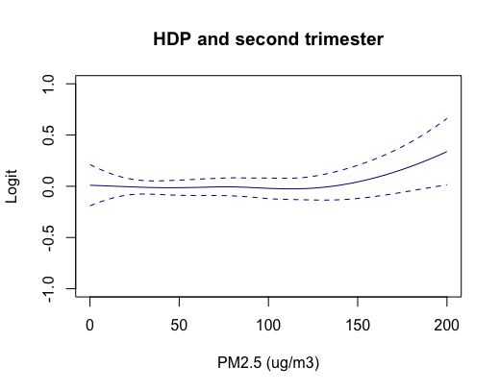
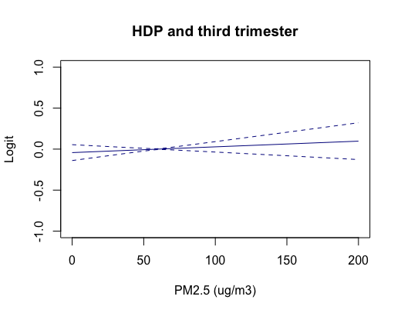
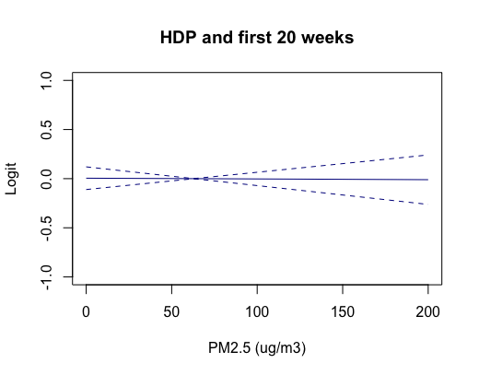
p=0.68
p=0.67
p=0.22
p=0.38
p=0.93

Slide 4
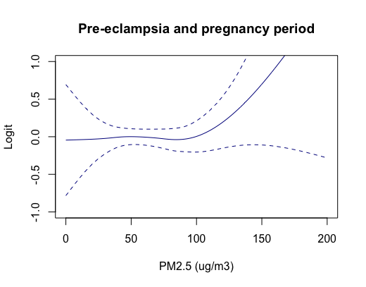
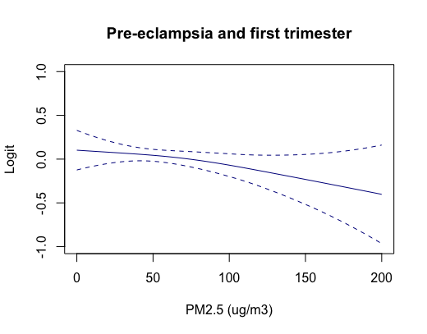
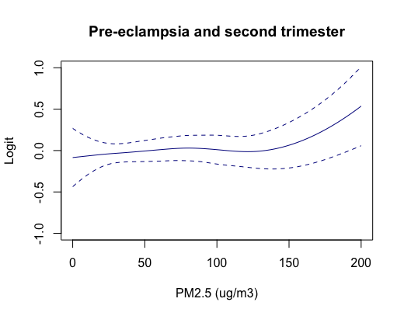
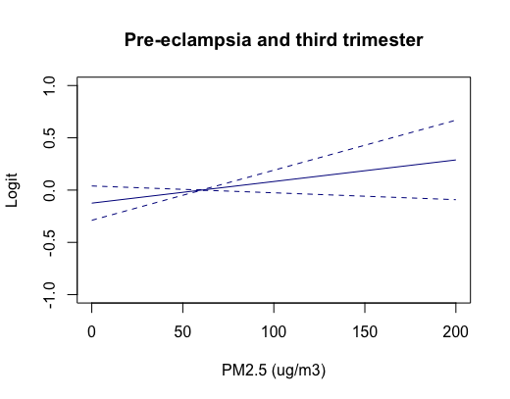
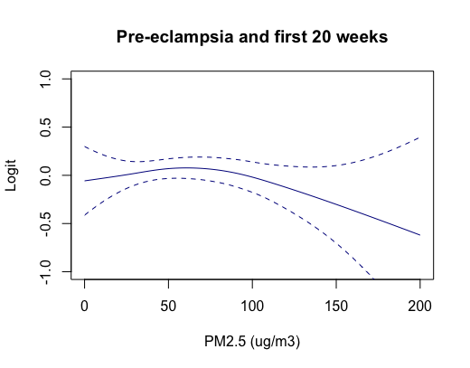
p=0.46
p=0.22
p=0.05
p=0.12
p=0.33

Slide 5
100 ug/m3
p=0.68

Slide 6
75 ug/m3
p=0.67

Slide 7
135 ug/m3
p=0.22

Slide 8
75 ug/m3
p=0.38

Slide 9
75 ug/m3
p=0.93

Slide 10
95 ug/m3
p=0.46

Slide 11
55 ug/m3
p=0.22

Slide 12
130 ug/m3
p=0.05

Slide 13
60 ug/m3
p=0.12

Slide 14
80 ug/m3
p=0.33

Slide 15
Green space

Slide 16
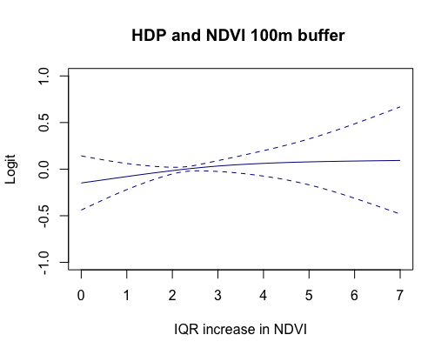
p=0.41

Slide 17
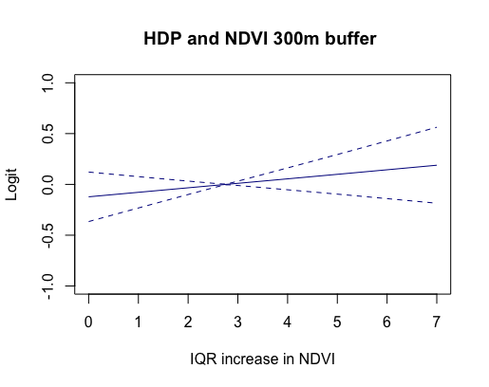
p=0.31

Slide 18
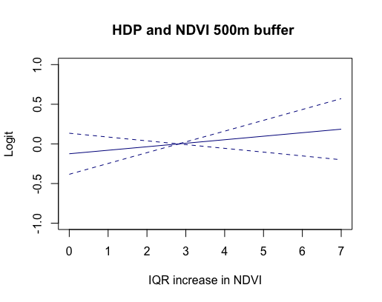
p=0.33

Slide 19
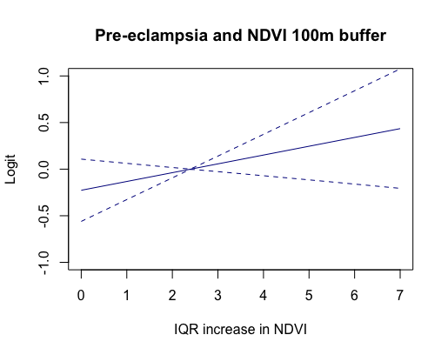
p=0.17

Slide 20
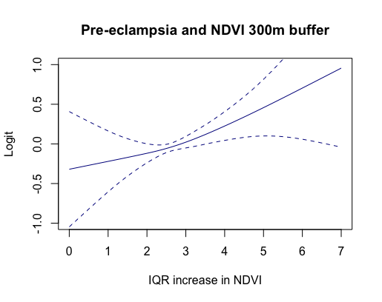
p=0.03

Slide 21
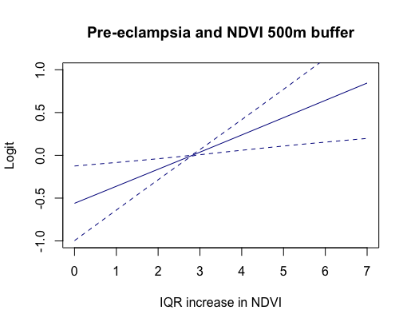
p=0.01

Slide 22
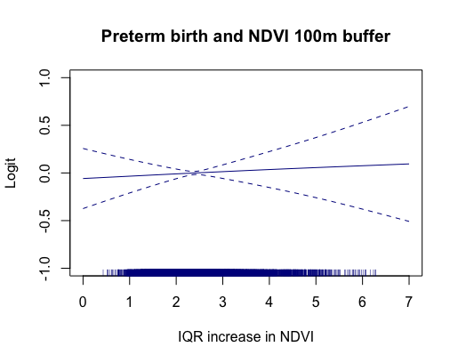
p=0.74

Slide 23
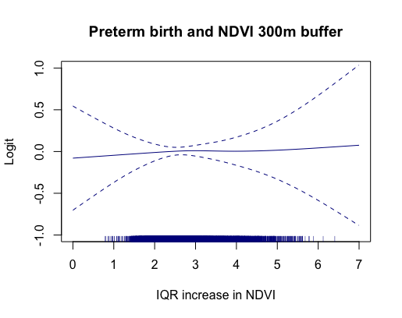
p=0.94

Slide 24
p=0.80

Slide 25
p=0.80

